Slide 1
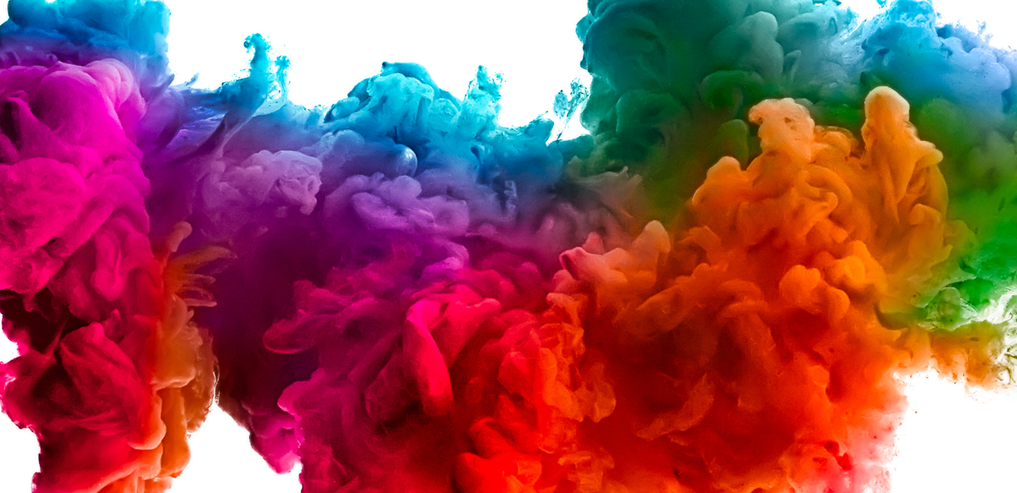
Pigment Printing Problems & Resolution

Slide 2
Binder Application in Different Style
Pigment Printing
Pigment Discharge Printing
Gold Printing
Silver Printing
Foil / Metallic Printing
Coating
Paint
Non-woven
Tape industries
Etc.

Slide 3
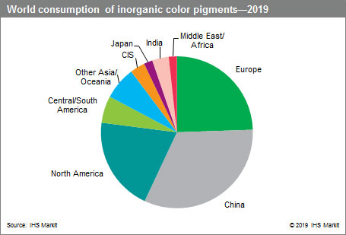

Slide 4
Pigment Printing System
General Guideline Recipes for Pigment Printing
Binder (38%) ---- min. 8% to % of Color *2.5
Fixer ----- 1-2%
Defoamer ----- 0.3% ( if found Foginess )
Ammonia ------- 1 -2% ( pH should be 8-8.5)
Softner -------- 1-2% ( Softness Requires )
Thickner ------- 1.5-3% ( To Achieve viscosity of 15000 cps to 20000 Cps)
Above stock paste color should be added .
Primary Requirement.
Pigment
Binder
Thickener
Secondary requirement
Fixer
Anti choking agent
Ammonia
Antifoam
Rheology Modifier
Softener

Slide 5
Pigment Printing Basics
Apply The Thickened Paste
Dry at 120 ̊̊C
Cure
180 ̊̊C/1min.
160 ̊̊C/3 min.
120 ̊̊C/5 min.

Slide 6
Basic Quality of Binders
Types of Binders
Vam – Acrylic Base Binders
Styrene – Acrylic Base Binders
Pure Acrylic Base Binders
Check Points Should be as below
a. % of Solid Content
b. % of Active content
c. Film on Glass plate
d. Tg of Binder
e. Nature ( Anionic /Non-ionic )

Slide 7

Difference between Dyes & Inorganic Pigments
DYES | PIGMENTS
1. Water solubility is 70% | 1. 100% water insoluble
2. Dyes have direct affinity to textile material | 2. They have no direct affinity to textile materials
3. Auxochrome groups are present | 3. Auxochrome groups are absent
4. Most of the dyes are organic | 4. Most of dyes are inorganic
5. Costly | 5. Cheap
6. No binding agent is required | 6. Binding agent is required
7. Dye diffusions in the fabric | 7. Pigment diffusion on the fabric

Slide 8
Gold Printing
Gold Powder : 200 to 300 gm
Gold Binder : 700 to 800 gm
Fixer : 20 gm
Total : 1000 gm
Silver Printing
Silver Powder : 200 to 300 gm
Acrylic Binder : 700 to 800 gm
Fixer : 20 gm
Defoamer : 3 gm
Ammonia(25%): 5 to 10 gm
Total : 1000 gm
Fabric Should be treated at Neutral pH . Similarly Acid liberating agent should not be used in paste because this products may have tendency of causing Tarnishing of Gold print
➔ It is advisable to give a thorough
hand stirring of the print paste prior to
printing. Machine stirring, causes foam
formation which leads to lesser brilliance
and is to be avoided.
It is advisable to provide exhaust in the polymerize to quickly expel if acid fumes any.
➔Fabric Should be treated at Neutral pH .
➔ It is advisable that add slowly with stirring add ammonia in solution of binder due self thickening effect
Drying & Curing Temperature should not be rise at given specification it might be damage fastness may be affected or tarnishing may be happen
pH Should be alkaline at the time of Printing.
Before adding Silver Powder to Binder paste add defoamer 1st then add other auxiliaries in this.

Slide 9
Sr | Test | Test Conditions | Gold Binder
1 | PHYSICAL APPEARANCE | Condition-Nil | Bluish White Emulsion
2 | SOLID CONTENT | Condition- 105°C for 1.5 hrs | 23.87 %
3 | VISCOSITY | Condition-On BF-RVT, SPL 4, RPM 20 at 30°C +/- 1°C | 53 Poise
4 | pH OF PRODUCT | Condition-(as such) | 7.0
5 | Tg (GLASS TRANSITION TEMP) °C | Condition - Perkin Elmer DSC 4000 Instrument | + 0.5 °C

Slide 10
Sr | Test | Test Specifications | Pure Acrylic Binder
1 | PHYSICAL APPEARANCE | Condition-Nil | Bluish White Emulsion
2 | SOLID CONTENT | Condition- 105°C for 1.5 hrs | 44.57 %
3 | VISCOSITY | Condition-On BF-RVT, SPL 2, RPM 20 at 30°C +/- 1°C | 0.1 Poise
4 | pH OF PRODUCT | Condition-(as such) | 3.0
5 | ACTIVE CONTENT | Condition- 2 gram sample dispersed in methanol + HCl | Not Found
6 | Tg (GLASS TRANSITION TEMP) °C | Condition - Perkin Elmer DSC 4000 Instrument | -5.0 °C
7 | Film Characteristics | Condition – Dried at 110°C for 1.5 hrs | Clear, Soft

Slide 11
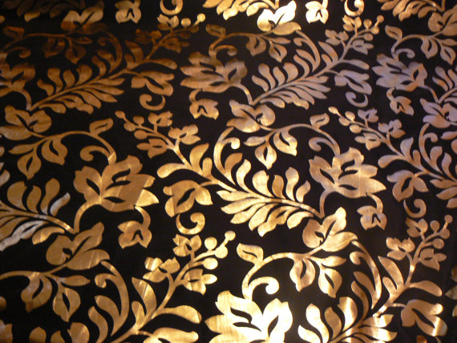
Foil Printing
Foil Should be done at directly with paste .
If we add fixer in same the fastness will improve nail rubbing fastness
Drying temperature should be at 120 ̊C
Curing should be done at 150 ̊C/5 Min.
Foiling should be done on Foiling Machine.

Slide 12
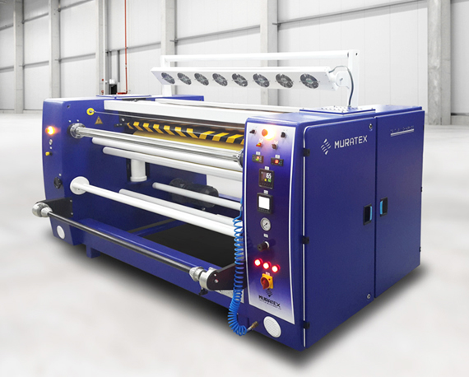

Slide 13
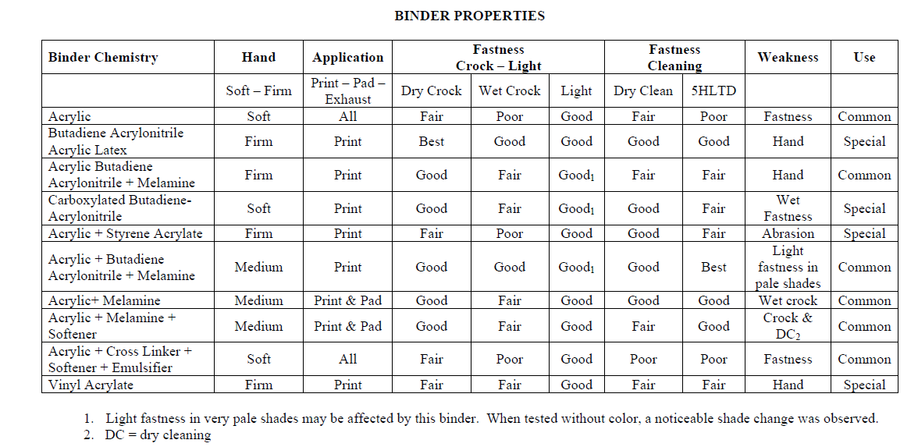

Slide 14
General Problems finds
in Pigment Printing

Slide 15
Symptoms | Diagnosis | Cure
Pigment Agglomeration | 1. Uncontrollable Amount of pigment | Reduce the excessive amount of thickener
 | 2. High Viscosity
Poor definition/Appearance | 1. Due to the use of duller pigment selection | 1. Use brightener pigments
 | 2. Lower rheology of the paste | 2. Select appropriate Reheology modifier and its amount
Screen Chocking | 1. High Viscosity of print paste | 1. Decrease the amount of thickener
 | 2. Poor Binder stability | 2. Check the quality and strength of binder
 | 3. pH Variation | 3. check the pH of the paste, it should be in alkaline medium
Poor light fastness | 1. Low light-fastness pigment | 1.Select appropriate pigment
 | 2. Fixer Quantity | 2. Use optimize amount of fixer
Dryness of shade | 1. Due to use of high amount of pigments | Reduce the excessive amount of pigments and thickener
 | 2. High paste viscosity

Slide 16
Symptoms | Diagnosis | Cure
Low Tinctorial Value | large particle size of pigment | Use small particle size of pigment
Poor colour yield | 1. lower viscosity | Increase appropriate amount of thickener and binder also check quality of Binder & Other Auxillaries
 | 2. poor colour stability
Reduction in Viscosity | 1. Hardness of water | 1. Use soft water & Salt free Water
 | 2. High conductivity of fabric | 2. Proper washing after pre-treatment is required
 |  | 3. Use stabilize thickener
Flushing | Low viscosity of the paste | 1. Increase the amount of thickener
 |  | 2. Use anti-flushing agents
Color penetration | 1.Thin fabric (low weight Fabric) | 1. Use appropriate amount of thickener with respect to fabric thickness and porosity
 | 2.High fabric absorbency

Slide 17
Symptoms | Diagnosis | Cure
Poor dry crock fastness | Insufficient amount of binder | 1. Increase binder
 |  | 2. Use appropriate amount of Fixer
Yellowing of shade | 1. Binder chemistry | 1. Use alternate binder
 | 2. Excessive drying of fabric | 2. Reduce the temperature of dryers
Stiffening of fabric | Excessive amount of binder | 1. Select Right Binders quality according to fastness requires
 |  | 2. Use Soft Binder less Tg Products
Poor wet crock fastness | Instability in binder film | Add Cross linker (Fixer)
Poor wash fastness | Instability in binder film | 1.Increase the amount of binder
 |  | 2. Add Cross linker (Fixer)
Rigidness in films | High amount of fixers | Optimize the amount of fixers
Immature Cross linking of binder during production run | 1.Due to increment in temperature | 1. Increase the amount of Liquor ammonia
 | 2. Poor binder stability | 2. Use suitable binder
 | 3. Low pH of the paste | 3. Increase the amount of urea
 | Instable pigment dispersion

Slide 18
Thank You

